Slide 1
Team OBD
Michael Dykema, Emily Linderman,
Tom Lobbestael, Jacob Johnson

Slide 2
Project Summary
An AWS data pipeline that will provide users with suggested content based on previously viewed content on odb.org. This pipeline is made up of a data lake that receives incoming data, a recommendation engine that makes recommendations based on the data from the lake, and an api that will export recommendations to odb.

Slide 3
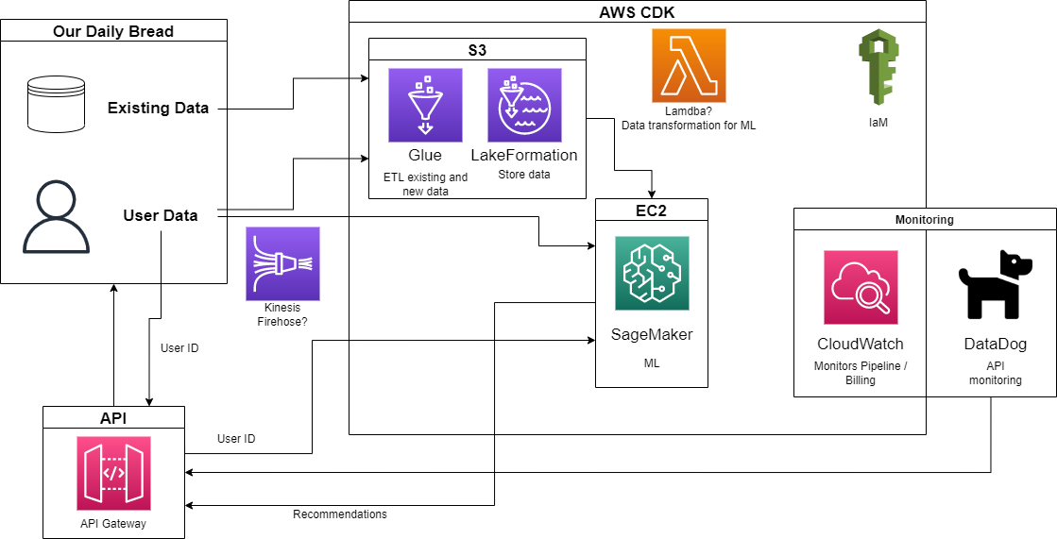
Architecture Overview

Slide 4
Issues
Delayed access to ODB’s AWS organization
  Very limited access and red tape from ODB hierarchy
Pull Request review and publishing done by ODB
  Different than initially expected and slows progress

Slide 5
Intended and Actual Progress - Michael
Complete
API Initialized
  Setup with simple Lambda function for now
Helped with Cloud Watch infrastructure
  Connected to API to monitor errors and cost
Helped with Lake Formation
Incomplete
Connecting API to SageMaker/Recommendation engine

Slide 6
Intended and Actual Progress - Emily
Complete
Get Access to AWS
Research - Cloudwatch
  Metric Data
  Alarm Creation
  Log Groups
Implementation
  Beginnings of Cloudwatch skeleton
Incomplete
Research
  Cloudwatch Events
  Cloudwatch Dashboards

Slide 7
Intended and Actual Progress - Tom
Complete
Get Access to AWS
Research - SageMaker
  Bucketing
  Tensorflow
Implementation
  SageMaker Initial Implementation
Incomplete
Research
  SageMaker Pipelining
  Further Improvement of Algorithm

Slide 8
Intended and Actual Progress - Jacob
Complete
Get Access to AWS
Research - Lake Formation
  Crawlers
  Data ingestion
  Log Groups
Implementation
  Data lake skeleton
Incomplete
Data lake deployment
Existing data ingestion into data lake

Slide 9
Incomplete
Import existing data into Data Lake - Waiting on ODB
Stream Data into Data Lake - Waiting on ODB
Connect API to recommendation engine

Slide 10
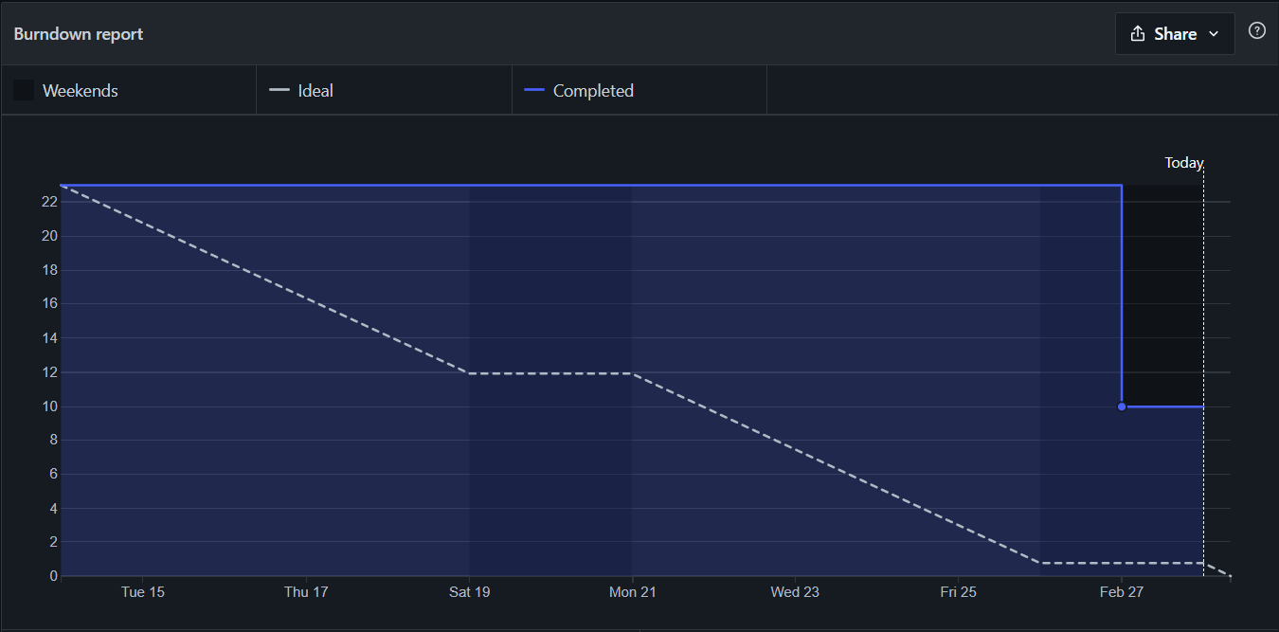
Burndown

Slide 11
Sprint #3 Project Progress
Overall Goals:
Data
Import data
  ODB responsibility
Stream new data in
Recommendation
Initialize SageMaker
Train model
API
Connect to recommendation engine
Monitoring
Connect to other service besides API
Individual Goals:
Jacob
Configure Glue for streaming data
Tom
Initialize SageMaker
Michael
Finish API
Emily
Initialize Cloud Watch dashboard

Slide 12
Demo coming next presentation

Slide 13
Questions?

